Slide 1
WHAT IS DEMOCRACY?
WHY DEMOCRACY?

Slide 2
What would have happened if India was not a democracy?
Could we have stayed together as a single nation?
/

Slide 3
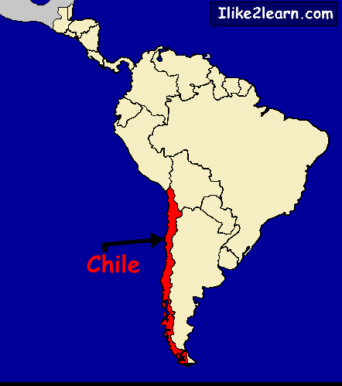
DEMOCRACY IN CHILE
Before Pinochet’s rule:
Allende – People elected the the ruler.
After Pinochet’s rule:
dictator’s rule
turned into democratic rule by by Michelle Bachelet.
7/7/2020
WHAT IS DEMOCRACY? WHY DEMOCRACY/ CIVICS/ Mrs. Sujatha/SOCIAL SCIENCE/SNS ACADEMY

Slide 4
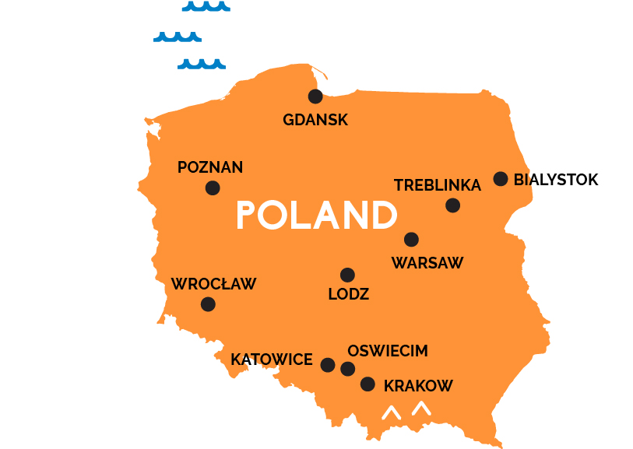
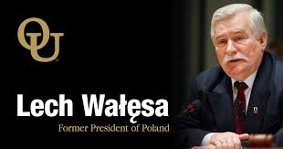
DEMOCRACY IN POLAND
Before Lech Walesa:
Poland’s workers party rule.
After Lech Walesa:
Democratic rule
7/7/2020
WHAT IS DEMOCRACY? WHY DEMOCRACY/ CIVICS/Mrs. Sujatha/SOCIAL SCIENCE/SNS ACADEMY

Slide 5
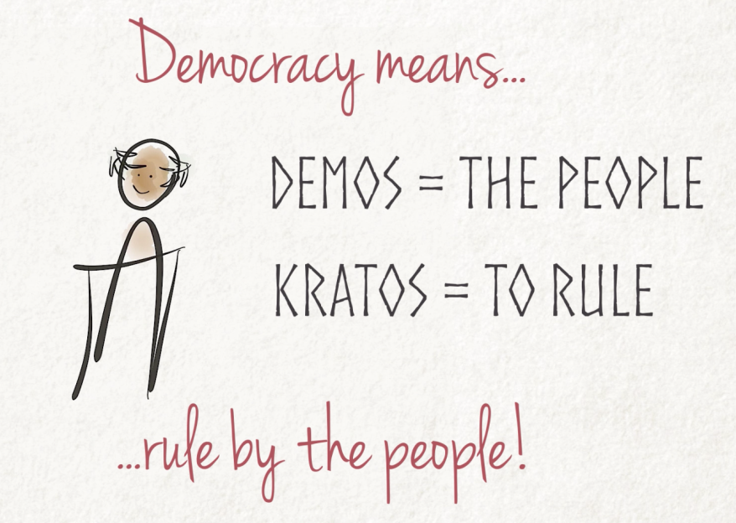
A simple definition of democracy:
Democracy is a form of government in which the rulers are elected by the people.

Slide 6
FEATURES OF DEMOCRACY:
Rulers
Election
People
Government

Slide 7
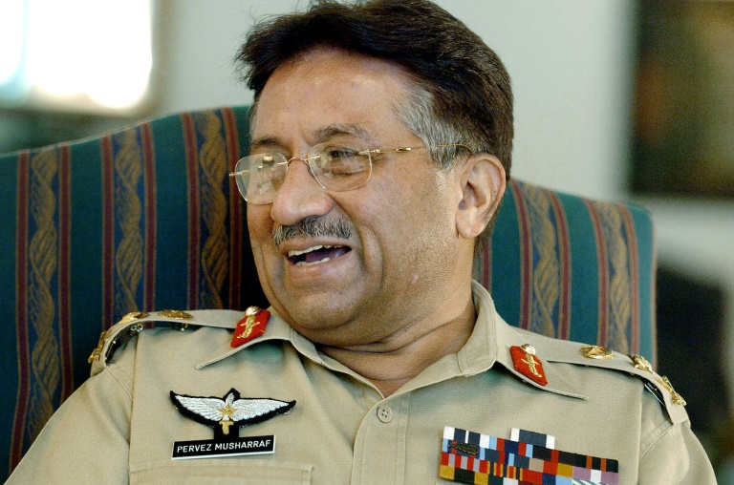
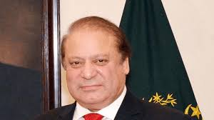
THE RULERS-Eg:
In 1999, General Parvez Musharraff overthrew Nawaz sahriff and declared himself chief executive of the country.
Changed his designation as the President.
In 2002, he issued legal framework order.
7/7/2020
WHAT IS DEMOCRACY? WHY DEMOCRACY/ CIVICS/ Mrs. Sujatha/SOCIAL SCIENCE/SNS ACADEMY

Slide 8
LEGAL FRAMEWORK ORDER.
7/7/2020
WHAT IS DEMOCRACY? WHY DEMOCRACY/ CIVICS/ Mrs. Sujatha/SOCIAL SCIENCE/SNS ACADEMY

Slide 9
WHAT IS DEMOCRACY? WHY DEMOCRACY/ CIVICS/Mrs. Sujatha/SOCIAL SCIENCE/SNS ACADEMY
7/7/2020

Slide 10
CONTENT SLIDE
WHAT IS DEMOCRACY? WHY DEMOCRACY/ CIVICS/ Mrs. Sujatha/SOCIAL SCIENCE/SNS ACADEMY

Slide 11
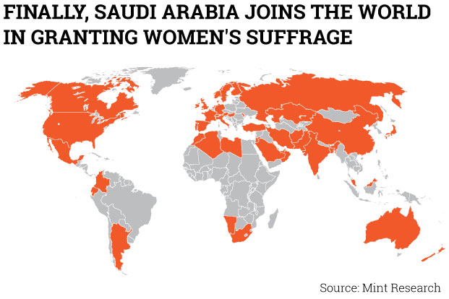
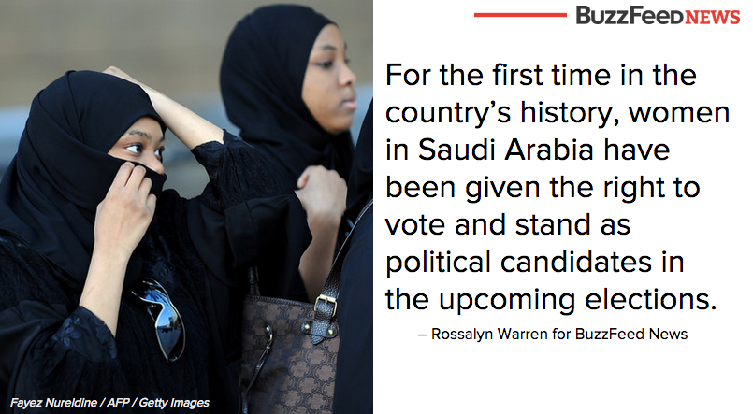
THE PEOPLE
WHAT IS DEMOCRACY? WHY DEMOCRACY/CIVICS/Mrs.. Sujatha/SOCIAL SCIENCE/SNS ACADEMY
7/7/2020

Slide 13
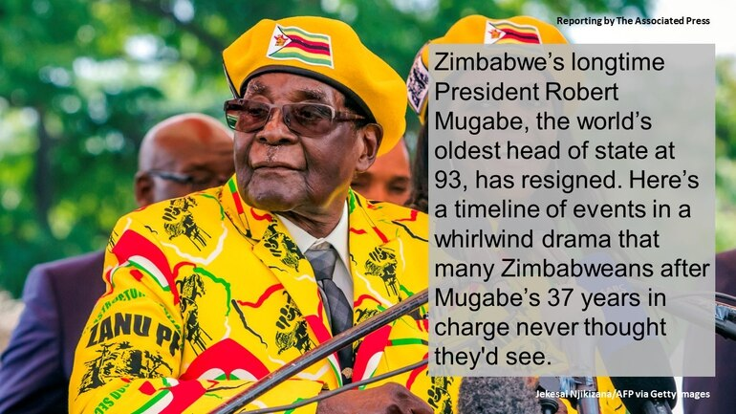
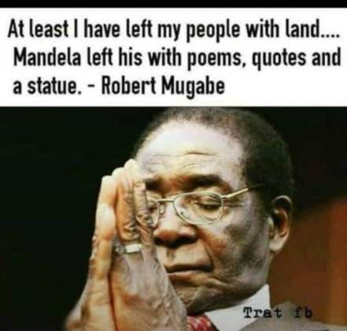
GOVERNMENT
.
7/7/2020
WHAT IS DEMOCRACY? WHY DEMOCRACY/ CIVICS /Mrs. Sujatha/SOCIAL SCIENCE/SNS ACADEMY

Slide 14
CONTENT SLIDE

Slide 16
Summary:
Democracy is a form of government in which the rulers are elected by the people.
Rulers elected by the people take all major decisions.
Elections offer a choice and fair opportunity to the people to change the current rulers.
This is available to all people on equal basis.
This leads to a government limited by basic rules of the constitution.
GEOGRAPHY/Mrs

Slide 17
WHY DEMOCRACY?
It is more accountable form of government.
It improves the quality of decision making.
Provides method to deal with differences and conflicts.
Enhances the dignity of citizens.
It allows to correct its own mistakes.

Slide 18
DEMOCRACY IS RULED BY ELECTED REPRESENTATIVES.
Impossible For such large number of people to to sit together and take decisions.
Citizens may not have time, skill and desire to take part in all the decisions.

Slide 19
REFERENCES
https://archive.nytimes.com/www.nytimes.com/ref/college/collegespecial9/adp-essayjaso.html?pagewanted=all
THANK YOU

